Slide 1
Labmeeting 8 March 2016
Physiological fluctuations and their correction using RetroicorPlus
Erno Hermans & Mariët van Buuren

Slide 2
Overview
Background physiological noise
Modeling physiological noise
Implementation & practical example: RETROICORPlus
Discussion / take home messages

Slide 3



Slide 4
Physiological pulsations: Respiration
Respiratory artifacts due to:
Head movement
Magnetic field homogeneity changes due to moving organs
Intra-thoracic pressure differences
Respiration-dependent vasodilation / oxygenation / HRF changes
Signal modulations resulting from respiration:
Respiratory phase
Respiratory frequency
Respiratory amplitude
Respiration Volume per Time unit (RVT)
Windischberger et al 2002 MRM
Hu et al.,1995;Glover et al., 2000:Wise et al. 2004
Birn et al. 2006;.van Buuren et al.,2009
Notes:
Head movement: rotation around x axis; translations in z; could be picked up by realignment
Movement of organs (lungs) outside of the FOV alter magnetic susceptibility; potential artifacts (phase encoding direction)
Intra-thoracic pressure: affects number of other physiological parameters; including heart rate
Low Respiration > vasodilation / changes in oxygenation
Signal modulations:
Respiratory phase:
Respiratory frequency: how fast you breathe
Respiratory amplitude: how deep you breathe

Slide 5
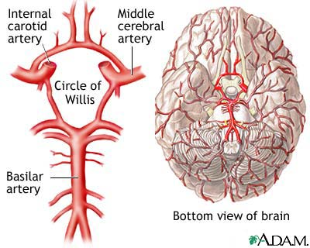
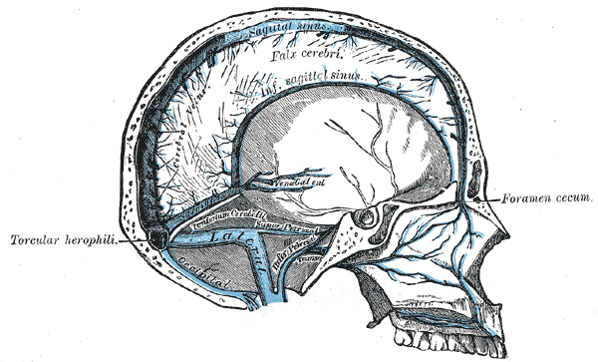
Physiological pulsations: Cardiac
Cardiac phase fluctuations (around blood vessels; arteries / veins)
Cardiac frequency effects on oxygenation
Hu et al.,1995;Glover et al., 2000:Dagli et al.,1999: Bhattacharyya & Lowe, 2004
Shmueli et al. 2007;.van Buuren et al.,2009
Notes:
- Phase fluctuations: signal fluctuation caused by changes in blood volume along the cardiac phase
Cardiac frequency: higher frequency > higher oxygenation > higher signal
Heart rate variability fluctuations: HR determined by sympathetic vs parasympathetic / HRV is high when parosym act is high; parasymp > vasodilation
Where to find these effects:
Vasculature of the brain
Arteries: blood is supplied from two sides; internal carotid artery and basilar artery,
blood joins at circle of wills (safety mechanism) from where it provides blood to the rest of the brain
From here: anterior (>frontal lobe), middle (forntal/temporal/parietal lobe), and posterior (temporal/occipital) arteries
Veins: superior sagittal sinus

Slide 6
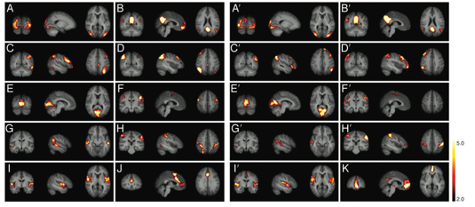
Who cares?
People who do connectivity analyses
2. Stress researchers
3. People who do high-resolution fMRI
Damoiseaux et al 2006 PNAS; de Luca et al 2006 NI; Lowe et al 1998 NI
Notes:
> connectivity relies on distant correlations. if physiological noise is correlated, this may explain FC
high-res: less smoothing, higher

Slide 7
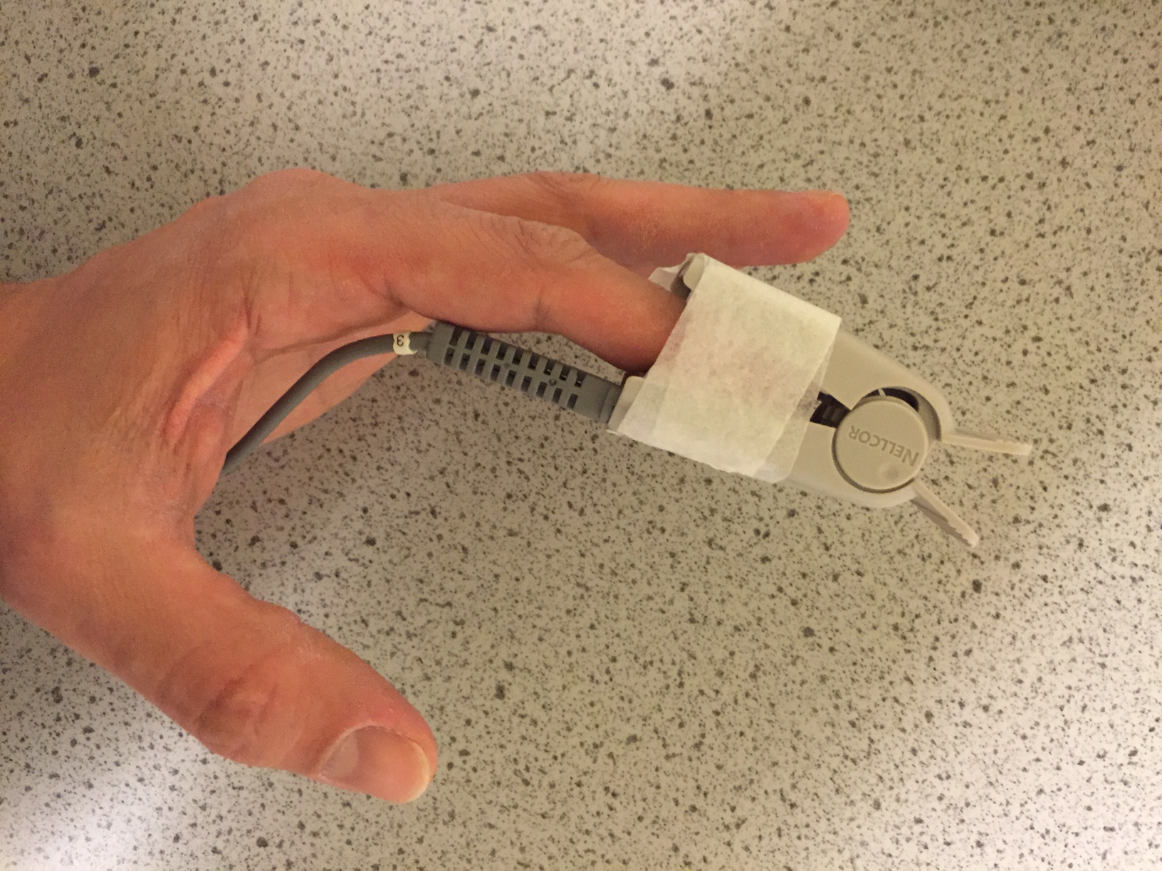
Finger pulse oximeter (photoplethysmograph)

Slide 8
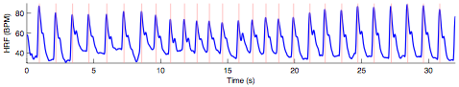
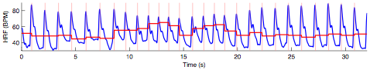
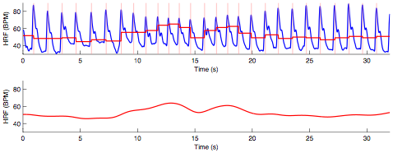
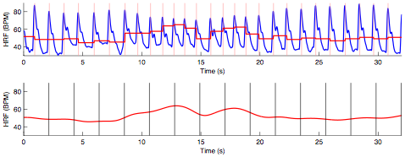
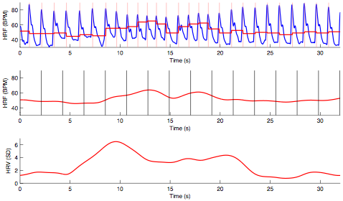
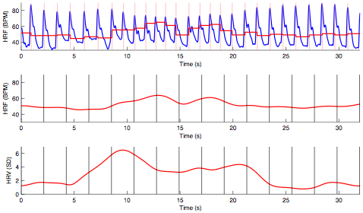
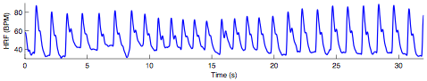
Modelling cardiac frequency

Slide 9
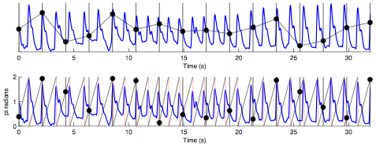
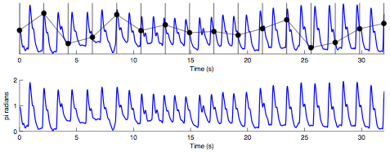
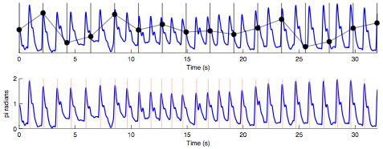
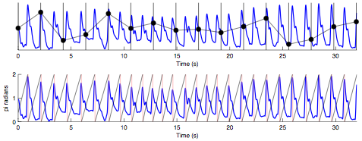
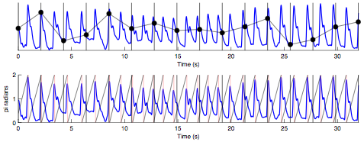
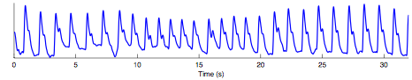
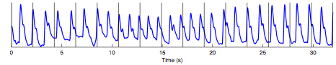
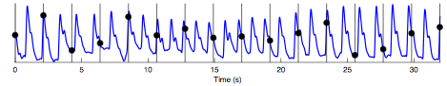
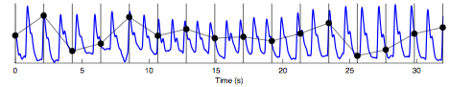
Modelling cardiac phase

Slide 10
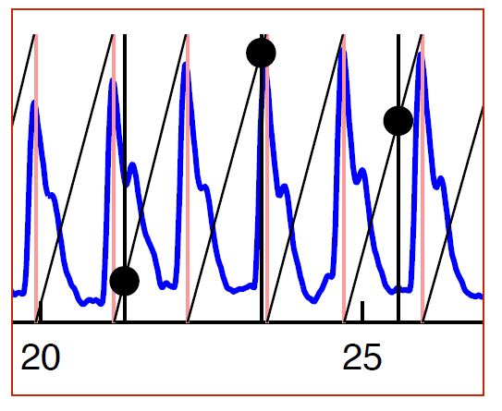
Modelling cardiac phase

Slide 11
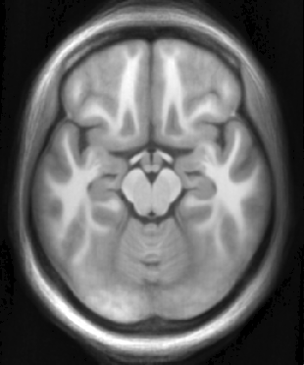
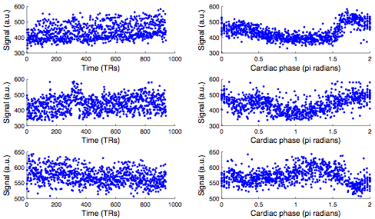
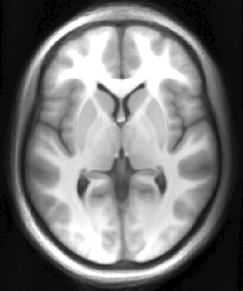
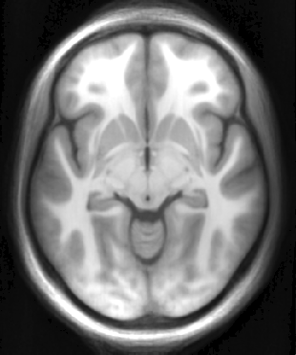
BOLD as a function of cardiac phase
Notes:
Notes:
Signal is strongly modulated by cardiac phase
Cardiac phase modulation is not at all uniform

Slide 12
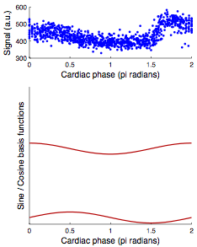
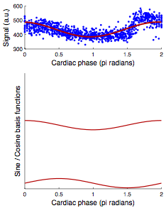
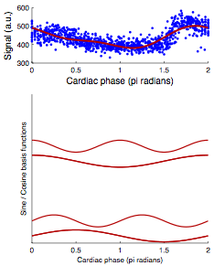
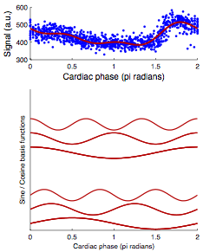
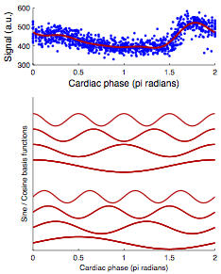
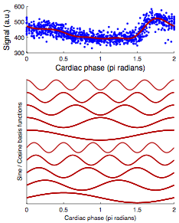
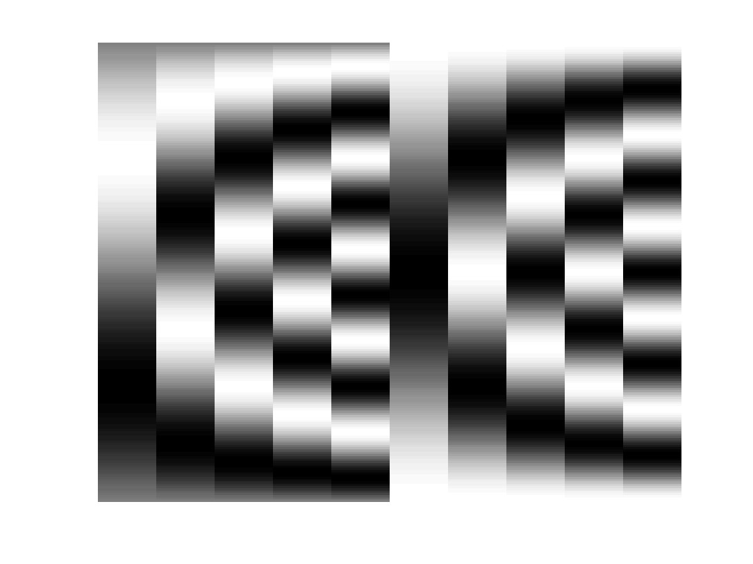
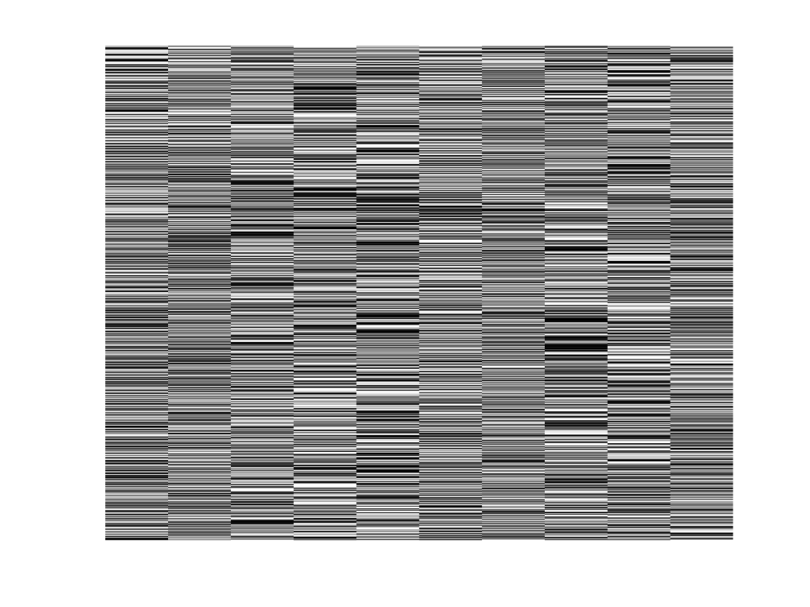
Fourier series
Cardiac phase
Time (TRs)
Fifth order Fourier series RETROICOR model; see Glover et al 2000 MRM; van Buuren et al 2009 HBM

Slide 13
Visualizing cardiac noise
Reconstructed cardiac phase modulation at 60 BPM (1Hz)
Enhanced contrast (1.5*)

Slide 14
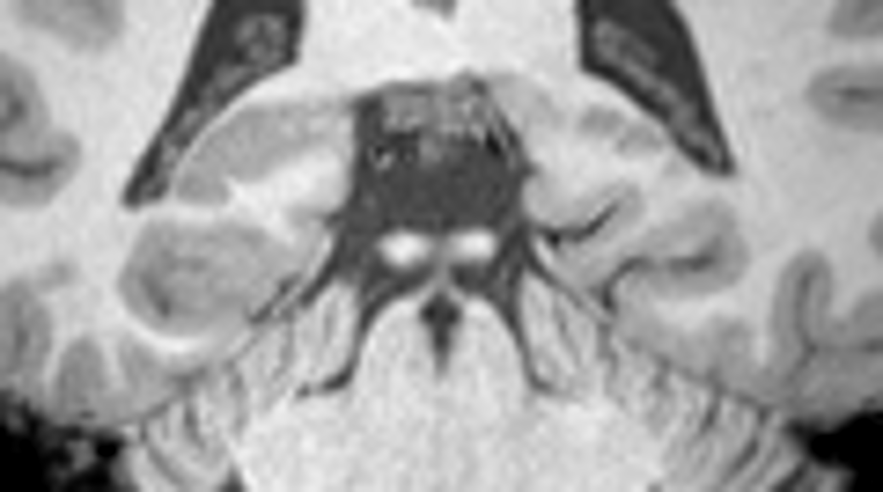
Cardiac noise in high-resolution brainstem imaging
Collin et al. in prep

Slide 15
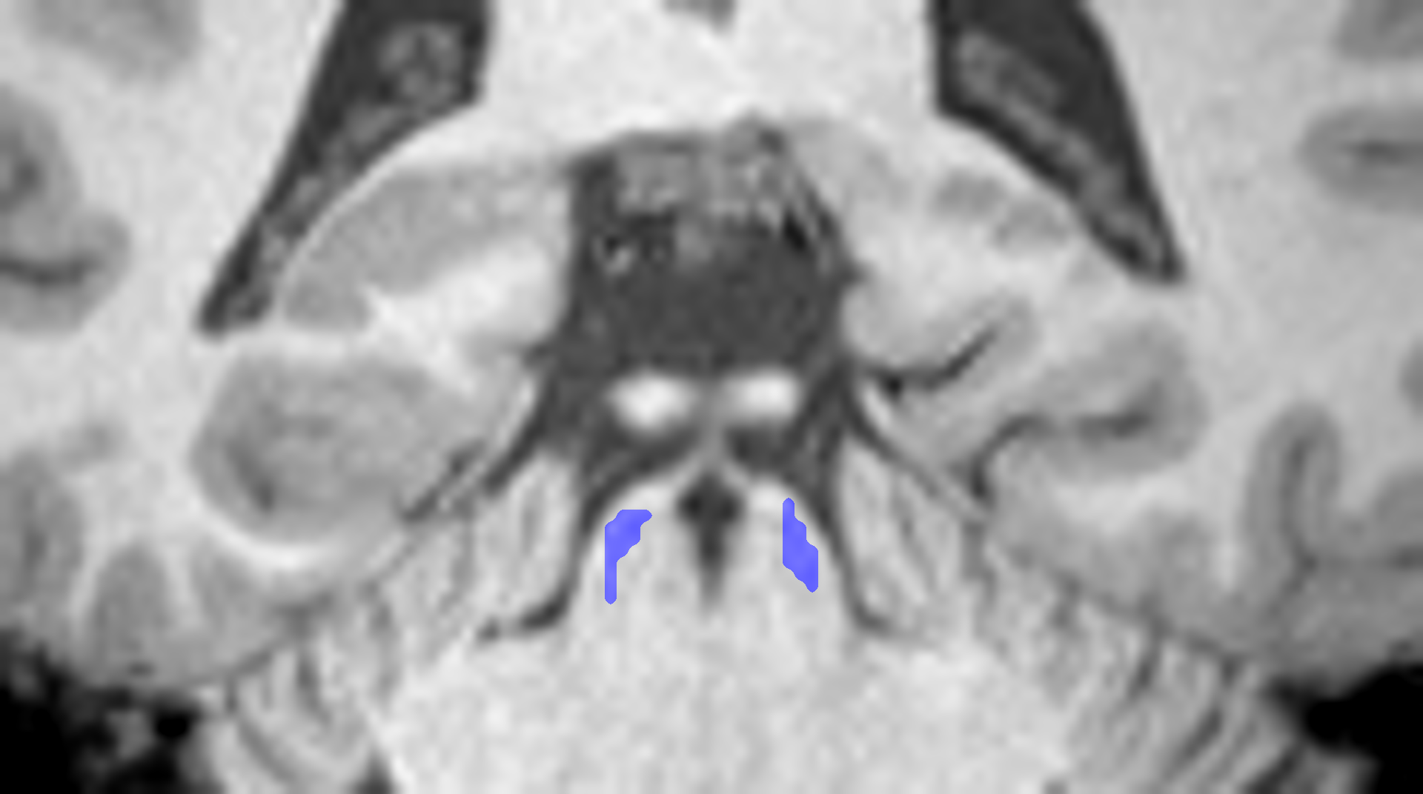
Cardiac noise in high-resolution brainstem imaging
Collin et al. in prep

Slide 16
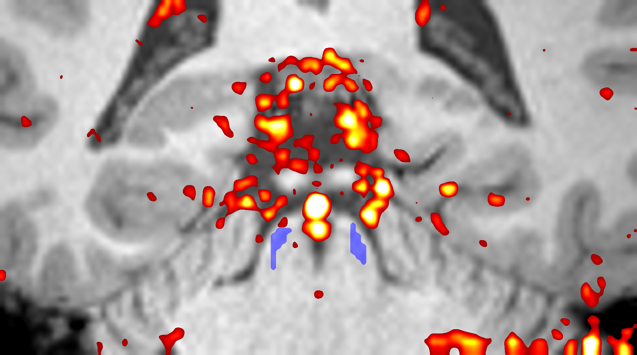
Cardiac noise in high-resolution brainstem imaging
Collin et al. in prep

Slide 17
Cardiac noise in high-resolution brainstem imaging
Collin et al. in prep

Slide 18
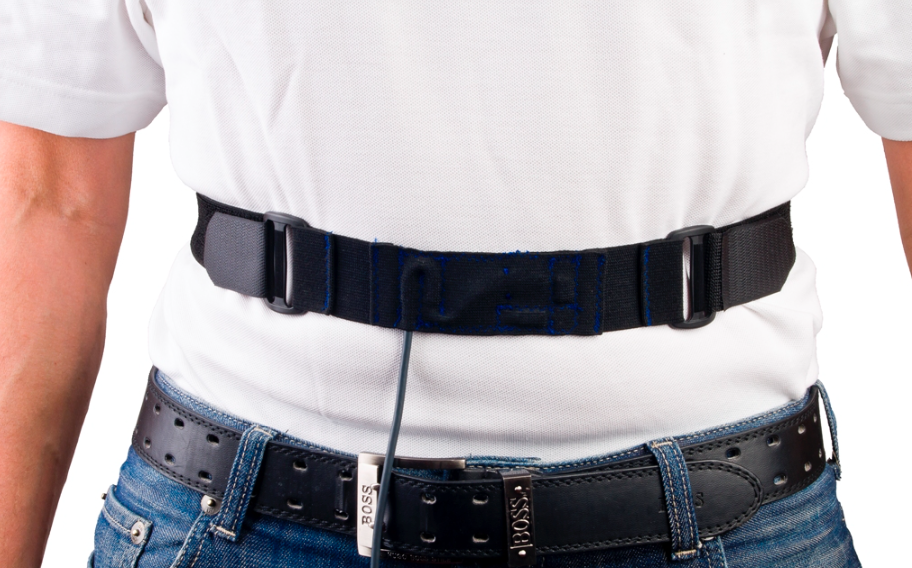
Measuring respiration in the MRI scanner

Slide 19
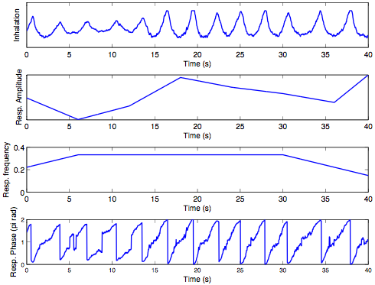
Modeling respiratory noise

Slide 20
Implementation and practical example: RETROICORPlus

Slide 21
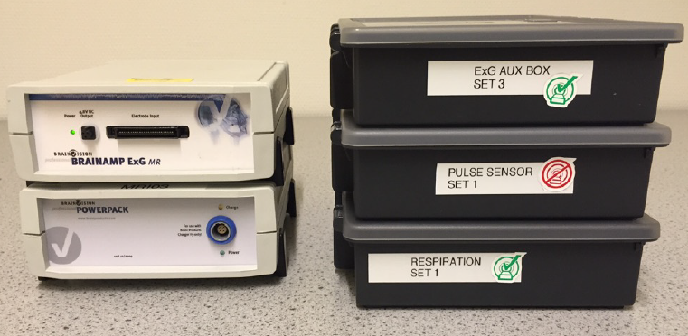
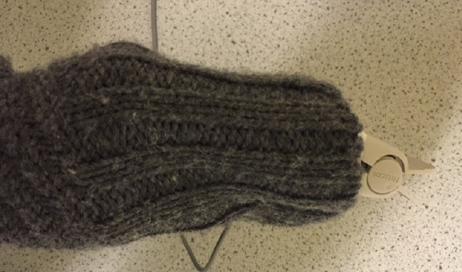
Equipment

Slide 22
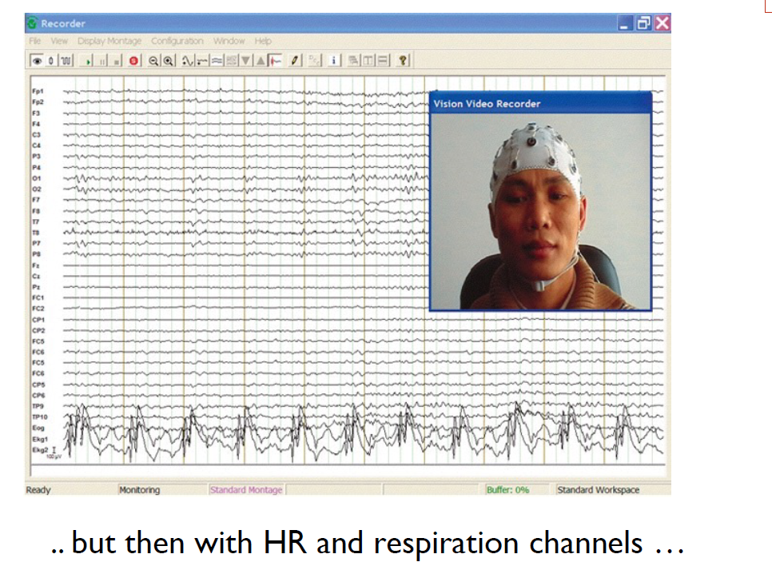
Equipment

Slide 23
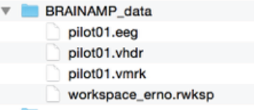
From .eeg file to mat.file: brainampconverter.m
brainampconverter.m:
Converts .eeg file to .mat file
Input: pilot01.eeg → output .mat and .puls file of each run
Contains scantriggers, heart rate signal (R-tops) and respiration signal

Slide 24
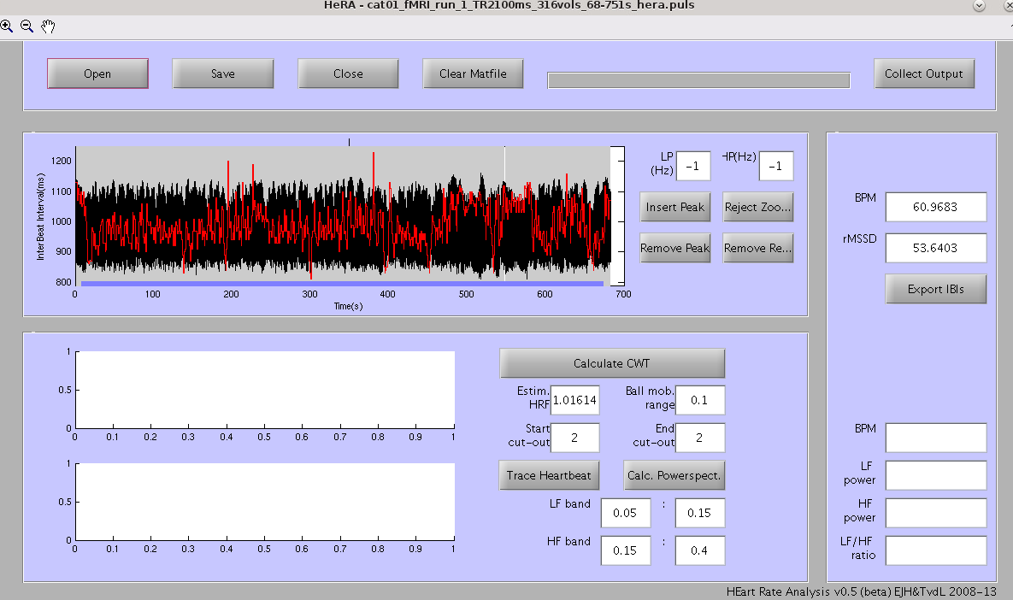
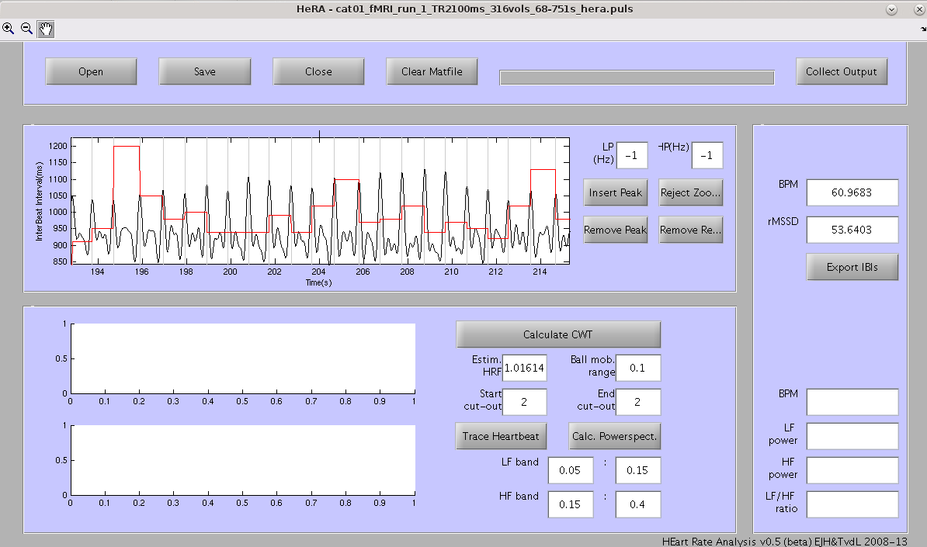
Hera – to remove spurious peaks and add peaks

Slide 25
Calculating regressors
RETROICORPlus:
Calculates regressors
Input:
mat file from hera
Nr of scans to be removed at beginning
Nr of scans to be removed at end
Output directory
Output:
Cardiac phase regressors (10)
Respiratory phase regressors (10)
Regressors HR frequency (4)
Regressors Respiration Volume per Time (amplitude * frequency) (4)

Slide 26
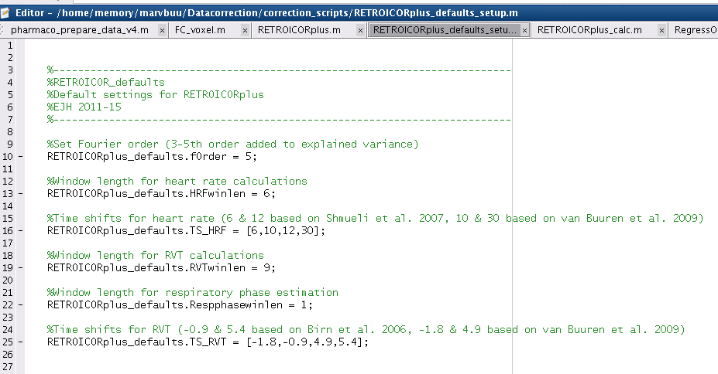
Calculating regressors

Slide 27
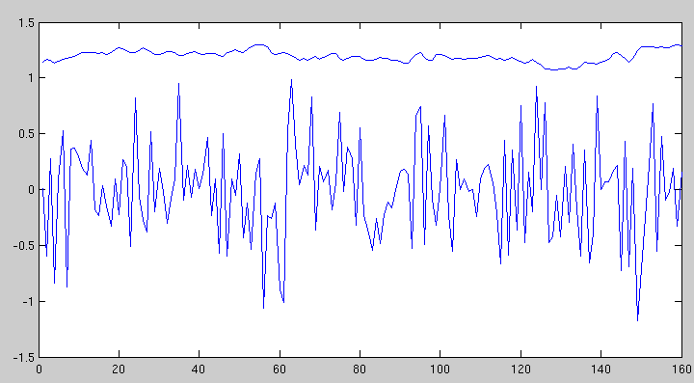
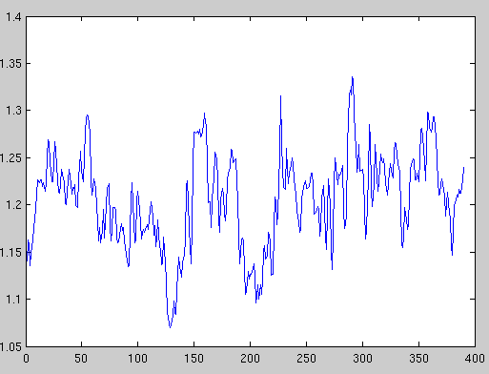
Calculating regressors – shifting HR & RVT regressors
HR
BOLD

Slide 28
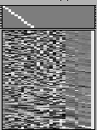
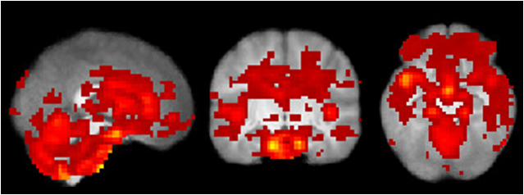
Cardiac phase signal modulation
p<.05, FWE corrected

Slide 29
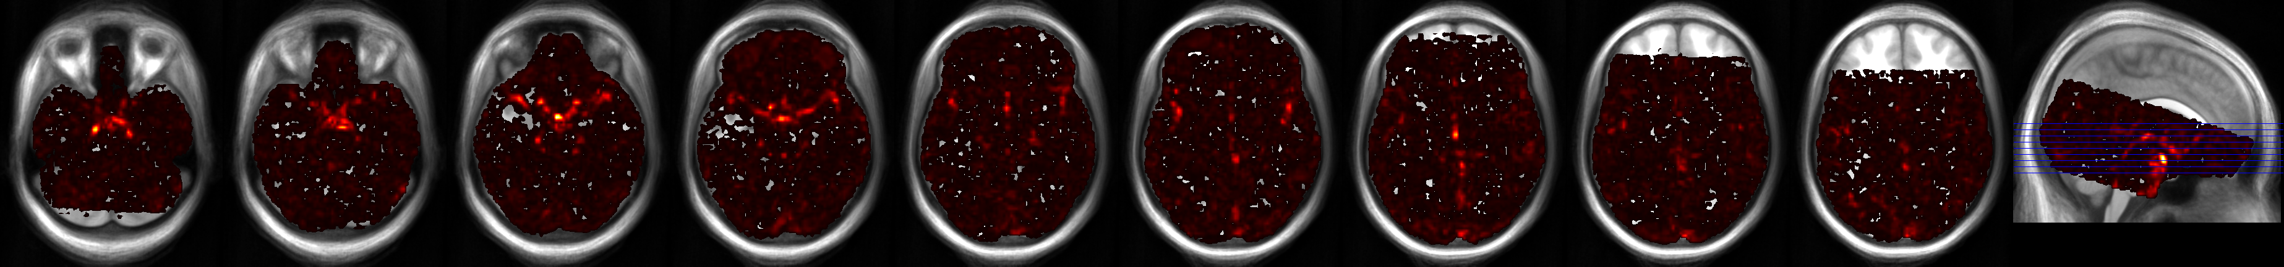


Cardiac phase signal modulation
F > 30
Notes:
Clearly around circle of willis(arterial side)
Veins: sagittal sinus

Slide 30


Respiratory phase modulation
p<.05, FWE corrected

Slide 31



Cardiac frequency signal modulations
Second-level, N=49
HR 6 seconds
Positive
p<.05, FWE corrected
Negative
p<.05, FWE corrected

Slide 32


Cardiac frequency modulation: HR 10 seconds
Second-level, N=49
HR 10 seconds
Positive NS
Negative
p<.05, FWE corrected
HR 12 seconds
Positive
Negative NS
p<.05, Cluster-corrected k=44

Slide 33

Cardiac frequency modulation: HR 10 seconds
Second-level, N=49
HR 30 seconds
Positive NS
Negative
p<.001, uncorrected

Slide 34



RVT signal modulations – Second-level N=49
RVT – 1.8 seconds
Positive
p<.05, cluster corrected k=40
RVT – 0.9 seconds
Positive
p<.05, cluster corrected k=48
p<.05, FWE

Slide 35


RVT signal modulations – Second-level N=49
RVT 4.9 seconds
Positive
p<.05, cluster corrected k=33
RVT 5.4 seconds
Positive
p<.0.001 uncorrected

Slide 36
Conclusions / take home messages
Conventional task-based fMRI may gain reliability from physiological corrections (esp. first-level).
Functional connectivity MRI may gain both reliability and validity.
Simple regression of heart rate / respiration frequency does not suffice, higher-order fourier series modeling is crucial (especially for heart rate).
Physiological noise produces not only signal modulation, but also movement.
Whether data driven methods (eg ICA) can fully capture physiological is an open question.
Increasingly relevant for low-TR (multi-band) imaging and high-resolution fMRI?

Slide 37
Thank you
Thanks to Bas Neggers, Thomas Gladwin, Matthijs Vink (UMC Utrecht, the Netherlands); Silvy Collin (Donders Institute); CBI at NYU New York
Donders Institute local implementation: available on request (erno.hermans@donders.ru.nl)

